Slide 1
Metabolism & ATP (Part 1 of 2)
Lecture 13

Slide 2
Objectives
Define the term metabolism and describe its main two pathways
Describe the structure of ATP and explain how it is used to carry and provide energy to the cell
List the two main ways of ATP production in the body
List the three main pathways of cellular respiration and know the site of each process
List the electron acceptor and non-electron acceptor coenzymes and show their related vitamins
Describe BRIEFLY the process of glycolysis
its main purpose
ATP accounting
its resulting products
List the three possible fates of pyruvate after it is produced from glycolysis

Slide 3
Metabolism
etymology (Gr. "to change")
catabolism
biochemical reactions that liberate the energy and couple it to the synthesis of ATP
anabolism/biosynthesis
biochemical reactions that utilize cell energy in ATP in order to synthesize larger molecules

Slide 4
Anabolism
Anabolic pathways (Greek “ana” = “up”)
Pathways synthesizing cellular components which often increase molecular size and require energy
Polymer synthesis & biological reduction of CO₂ to sugar are examples of anabolic pathways

Slide 5
Catabolism
Catabolic pathways (Greek ”kata”= “down”)
Pathways involving breakdown of cellular constituents which decrease molecule size and are energy-releasing
Biochemical reactions are usually oxidations or hydrolysis
Catabolic pathways play two roles:
They release the free energy needed to drive cellular functions
They give rise to small organic molecules (metabolites) that are the building blocks for biosynthesis

Slide 6
ATP As The Energy Go-Between
Primary "Energy Currency of the Biological World"
Food fuels cannot be used to energize body activities directly
Energy from food (glucose catabolism) is stored in the bonds of adenosine triphosphate (ATP)
Energy for cellular processes of all kinds is then coupled to the break-and-transfer of ATP phosphate anhydride bond energy
Many metabolic (catabolic and anabolic) utilize ATP or create ATP
ATP can be regenerated in metabolic processes fundamental to photosynthesis in the plant chloroplast and respiration in mitochondria

Slide 7
ATP Structure
ATP consists of adenine + ribose + three phosphates
Adenine + ribose = adenosine
AMP = adenosine monophosphate: this phosphate is attached by an ester bond without high energy
ADP = adenosine diphosphate: the second phosphate is attached by a high energy phosphate bond
In ATP: the third phosphate is attached by an even higher energy phosphate bond
High energy phosphate bonds in ATP are NOT highest energy phosphate bonds possible in the cell: they are intermediate on the energy scale of phosphate bonds
This makes ATP a useful because the 3rd phosphate bond is of sufficiently high energy to enable metabolism, but not so high that it is difficult for cell to make

Slide 8
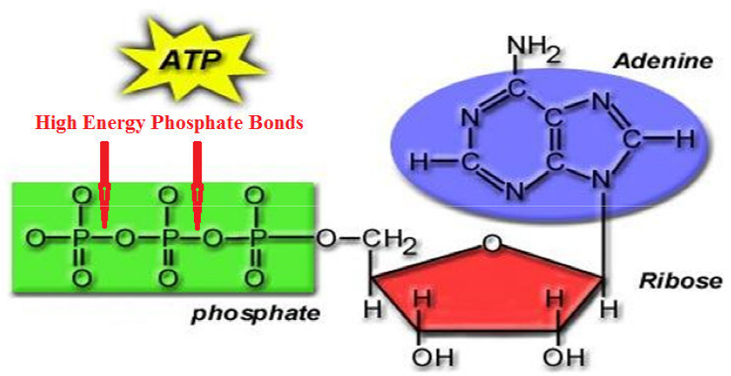

Slide 9
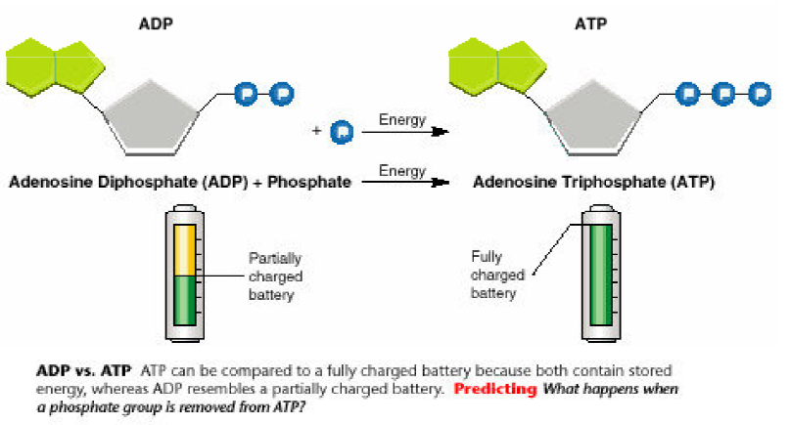
All energy is stored in the bonds of ATP: breaking the bond releases the energy
When the cell has energy available it can store this energy by adding a phosphate group to ADP, producing ATP

Slide 10
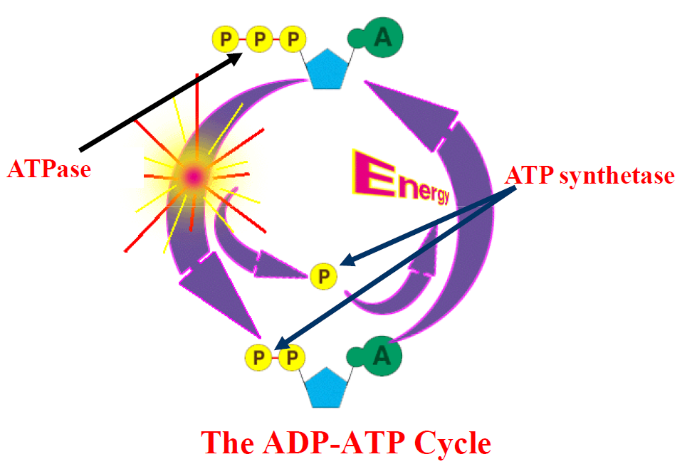

Slide 11
Energy Source for Producing ATP
ATP is produced during a process called cellular respiration
The energy comes ultimately sunlight, which was used to drive glucose formation by photosynthesis, which is utilized by the cell, and creates again the materials for photosynthesis:
The energy which is stored in the whole glucose molecule is approximately 100-fold the amount of energy which is stored in a high-energy phosphate bond in 1 ATP molecule
Therefore, we release the energy from glucose step-wise, releasing tiny packets of energy so that ATP can be synthesized one molecule at a time, where possible.

Slide 12
Cellular Pathways for Producing ATP
ATP may be made in 2 ways:
Substrate-level phosphorylation utilizes the energy of a single exergonic substrate conversion to directly power the phosphorylation of ADP to make ATP
This is ATP that is formed by biochemical reactions within metabolic pathways like glycolysis & TCA (Krebs) cycle
Oxidative phosphorylation utilizes the energy of alternating oxidation and reduction of coenzymes in the electron transport system (ETS) to make ATP

Slide 13
Glucose → ATP Metabolic Pathways
Three pathways in fundamental cellular metabolism:
Glycolysis
occurs in cytosol
2. Tricarboxylic acid (TCA) cycle
also called Krebs cycle after its discoverer
occurs in the mitochondria matrix
Electron Transport Chain or System (ETS/ETC)
occurs in the mitochondria inner membrane
These three pathways will produce a net total of 36 ATP molecules: 2 from glycolysis, 2 from Krebs cycle, and 32 from ETS, all from one glucose molecule
These metabolic pathways occur in a definite order, and we will consider them in that order

Slide 14
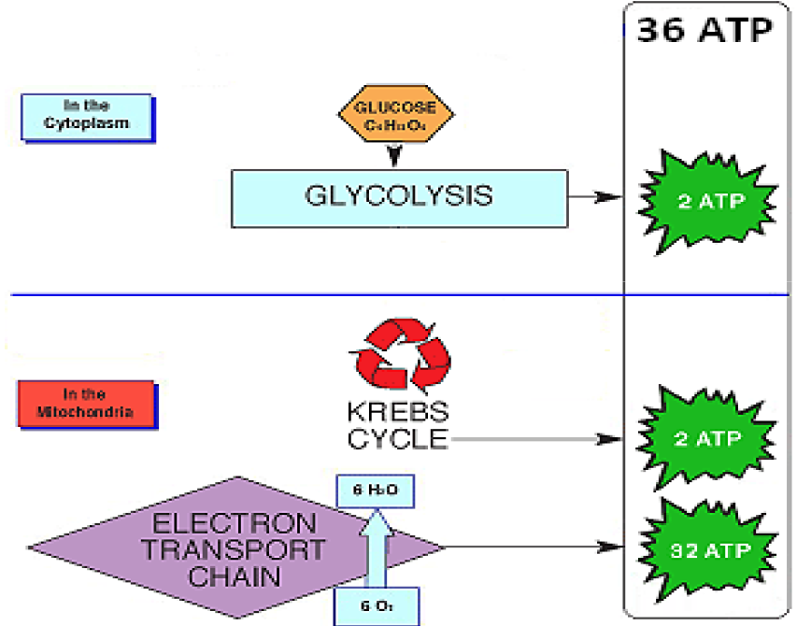

Slide 15
Cofactors / Coenzymes
It should be noted that many components in these pathways rely on molecules that are derived from vitamins
Nicotinamide adenine dinucleotide (NAD⁺) is involved in redox reaction and is made from nicotinamide or niacin, vitamin B₃
Flavin adenine dinucleotide (FAD) is made from riboflavin, or vitamin B₂ and involved in redox reactions
Flavin mononucleotide (FMN) is a derivative of riboflavin
Coenzyme Q is not derived from a vitamin, but an important redox component
Cytochromes are redox proteins with iron- and copper-containing heme components
Thiamine pyrophosphate (TPP) is made from thiamine, vitamin B₁ and is involved in the pyruvate dehydrogenase reaction
Coenzyme A is made from pantothenate, vitamin B₅.

Slide 16
Glycolysis Overview
10 enzymatic reactions all in the cytosol
Starts with one 6-carbon glucose and finishes with two 3-carbon pyruvate molecules
Two ATP are used at first
one by enzyme hexokinase to phosphorylate glucose (Glc) to glucose-6-phosphate (G6P) as it enter cells through the glucose transporter
this traps Glc, since it can actually diffuse out of the cell
the other is by phosphofructokinase (PFK), which phosphorylates fructose-6-phosphate (F6P)–isomerized from G6P to fructose-1,6-bisphosphate (FBP)

Slide 17
Glycolysis Overview
Later, four ATP molecules will be produced from one Glc
Thus a net gain of two ATP is produced from the one metabolic pathway that is glycolysis
This ATP produced is called substrate level phosphorylation, because all the ATP produced are from reactions with metabolic pathway substrates (carbohydrate molecules)
Later, far more ATP molecules will be generated by oxidative phosphorylation
Another important energy-producing step is the generation of two NADH molecules from NAD⁺ + H⁺

Slide 18
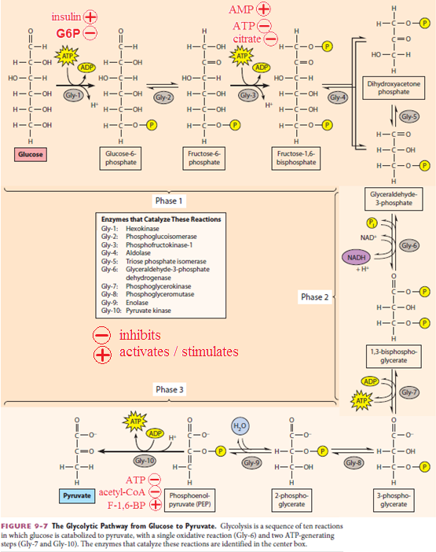
10 enzymatic steps from glucose to pyruvate

Slide 19
Summarizing the Detail
Reactions 1-3: preparation
Glucose is phosphorylated to make fructose 1,6- bisphosphate. Two molecules of ATP are used up in this process.
Reactions 4-5: cleavage
Fructose 1,6-bisphosphate is split into two molecules, which at first are slightly different from each other. One of them undergoes an isomerization to make them the same, so we end up with two identical molecules of glyceraldehyde-3-phosphate. From this point, the process is in duplicate if we think on a "per glucose" basis.

Slide 20
Summarizing the Detail
Reactions 6-7: oxidation & ATP production
Glyceraldehyde-3-phosphate is oxidized to 3-phosphoglycerate. (Note that this reaction oxidizes an aldehyde to a carboxylic acid). This is an oxidation, so it requires an electron acceptor, which is NAD⁺ → NADH + H⁺. ATP is produced through substrate-level phosphorylation.
Reactions 8-10: molecular rearrangement & ATP production
3-phosphoglycerate undergoes three rearrangements, and then its energy is in the right place for it to be used for substrate-level phosphrylation to make more ATP. The final product is pyruvate.

Slide 21
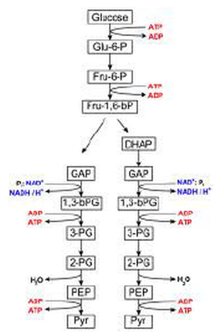
Taken from a previous lecture, this shows
the energy-using and –producing steps
the metabolic pathway from GAP → pyruvate is duplicated because 6C molecules split to two 3C molecules

Slide 22
Pyruvate → Acetyl-CoA
After forming in glycolysis, pyruvate enters into the mitochondrial matrix: it must be transported across inner membrane
Pyruvate dehydrogenase is a protein complex with multiple enzymatic activities and intermediate metabolites
It will produce one NADH and one CO₂ molecule
It will use Coenzyme A to store a high energy bond in the 2-carbon acetyl product: acetyl-CoA, which then enter the TCA (Krebs) cycle

Slide 23
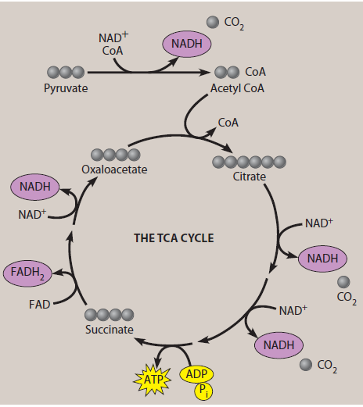
The pyruvate dehydrogenase reaction is shown in the reaction outlined in red
It joins glycolysis with the TCA (Krebs) cycle

Slide 24
Fermentation (Anaerobic Metabolism)
When oxygen is not available for production of ATP by respiration, NAD⁺ used by the reaction of glyceraldehyde-3-phosphate dehydrogenase is depleted
Cells have an "escape" pathway to regenerate NAD+ so that glycolysis can at least continue
This is called fermentation
There are two types of fermentation pathways
Lactate
Ethanol + carbon dioxide

Slide 25
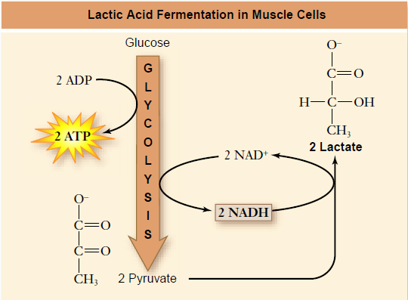
Lactate Fermentation
This happens when skeletal muscle cannot get oxygen to make it work
Pyruvate builds up as glycolysis occurs rapidly in muscle movement
The pyruvate is converted to lactate by the enzyme lactate dehydrogenase, which uses NADH to reduce pyruvate to lactate: this restores NAD⁺ concentrations so glycolysis can continue

Slide 26
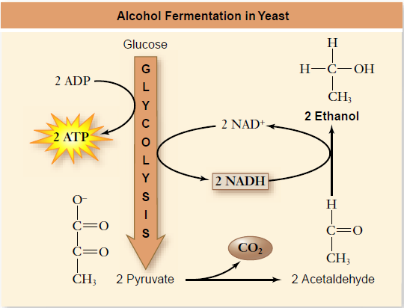
Alcoholic Fermentation
This metabolic pathway occurs in yeast and is the basis for wine, beer, and distilled spirits production
Instead of one enzyme (LDH) for the lactate pathway, this pathway uses two enzymes:
pyruvate decarboxylase catalyzes the loss of CO₂ from pyruvate to form acetaldehyde
alcohol dehydrogenase converts acetaldehyde to ethanol, and is the enzymatic step restoring NAD⁺ from NADH

Slide 27
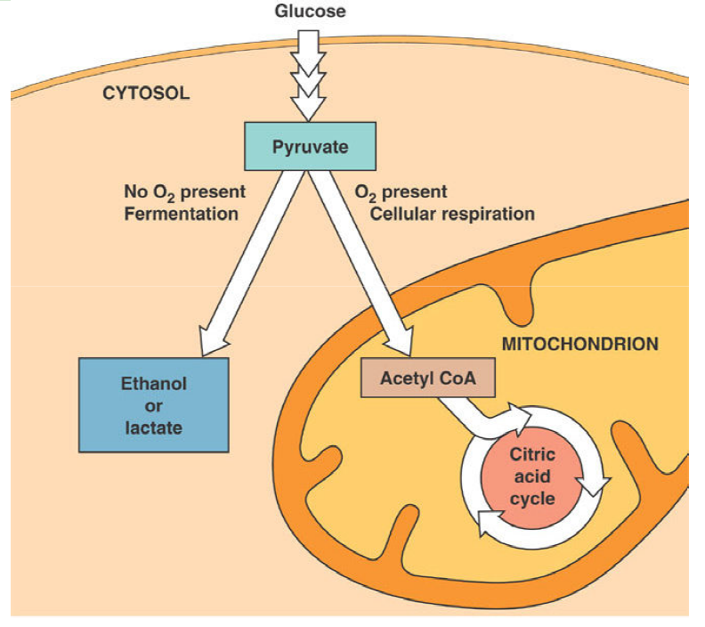

Slide 28
Reading
Becker's WotC: 224-236, 252-263, 267-272, 274-288
Raven: pp 108-110, 112-113, 117-119, 123-138

